Slide 1

Functional Programming

Slide 2

Keith Harrison
Head of Development - Nude

Slide 3
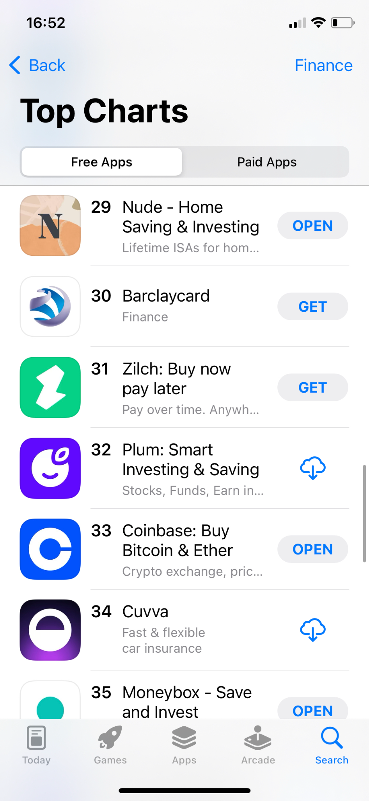
Nude
Helping people save for their first home
Home ownership end > end
Insights + Savings account
FCA regulated
£7.4 million in funding
⭐ We are hiring ⭐

Slide 4
Built around best practice
TDD
Integration test
Code review
https://getnude.com/careers
keith@getnude.com

Slide 5
What is functional programming?

Slide 6

What is functional programming?
“In computer science, functional programming is a programming paradigm where programs are constructed by applying and composing functions.”
Programming Paradigms
Imperative
Procedural
Object-orientated
Declarative
Functional
Logic
SQL
Notes:
Programming paradigms – a way to classify programming languages based on their features.

Slide 7
Other features

Slide 8
Immutability
let x = 1
x = 2 // Not allowed
Notes:
First class citizen - In programming language design, a first-class citizen in a given programming language is an entity which supports all the operations generally available to other entities. These operations typically include being passed as an argument, returned from a function, and assigned to a variable.

Slide 9
Pure functions
// Not pure
var count = 1
function incrementCount(){
return count + 1;
}
// Pure
let incrementCount(count) =
count + 1
Notes:
First class citizen - In programming language design, a first-class citizen in a given programming language is an entity which supports all the operations generally available to other entities. These operations typically include being passed as an argument, returned from a function, and assigned to a variable.

Slide 10
Functions as first class citizens
let add(a, b) =
a + b
let total = add(1, 2)
Notes:
First class citizen - In programming language design, a first-class citizen in a given programming language is an entity which supports all the operations generally available to other entities. These operations typically include being passed as an argument, returned from a function, and assigned to a variable.

Slide 11
let createAdder(getAmount) =
(x) -> x + getAmount()
Notes:
First class citizen - In programming language design, a first-class citizen in a given programming language is an entity which supports all the operations generally available to other entities. These operations typically include being passed as an argument, returned from a function, and assigned to a variable.

Slide 12
public class Multiplier {
public int Factor;
public int Calculate(int value) {
return value * Factor;
}
}
var tenMultiplier = new Multiplier { Factor = 10 };
var result = tenMultiplier.Calculate(2);
Notes:
First class citizen - In programming language design, a first-class citizen in a given programming language is an entity which supports all the operations generally available to other entities. These operations typically include being passed as an argument, returned from a function, and assigned to a variable.

Slide 13
let createMultiplier (factor) =
(x) -> x * factor
let multiplyByTen = createMultiplier(10)
let result = multiplyByTen(2)
Notes:
First class citizen - In programming language design, a first-class citizen in a given programming language is an entity which supports all the operations generally available to other entities. These operations typically include being passed as an argument, returned from a function, and assigned to a variable.

Slide 14
Putting it all together…

Slide 15
let filter(people) =
let results = new List<Person>()
for person in people do
if person.Age > 30 then
results.Add(person)
results

Slide 16
let filter(age, people) =
let results = new List<Person>()
for person in people do
if person.Age > age then
results.Add(person)
results

Slide 17
let filter(people) =
let results = new List<Person>()
for person in people do
if person.Gender == 'male' then
results.Add(person)
results

Slide 18
let filter(filterFunction, people) =
let results = new List<Person>()
for person in people do
if filterFunction() then
results.Add(person)
results

Slide 19
let filter(filterFunction, people) =
let results = new List<Person>()
for person in people do
if filterFunction() then
results.Add(person)
results
filter((p -> p.Age > 30), people)
filter((p -> p.Age > 40), people)
filter((p -> p.Gender == 'male'), people)

Slide 20
let isOver30 p = p.Age > 30
let isOver40 p = p.Age > 40
let isMale p = p.Gender == 'male'
filter(isOver30, people)
filter(isOver40, people)
filter(isMale, people)

Slide 21
filter isOver30 people
people |> filter(isOver30)

Slide 22
people |> filter(isOver30)
|> filter(isMale)

Slide 23
Downsides
Learning curve
Performance
Unit testing

Slide 24
Functional support in popular languages

Slide 25
JavaScript
Functions as first class citizens
Closures
Anonymous functions

Slide 26
JavaScript
Lodash
const menOver40 = _(people)
.filter(p => p.Age > 40)
.filter(p => p.Gender == 'male')
.value();

Slide 27

Python
Functions as first class citizens
Closures
Anonymous functions

Slide 28
Python
Built in functions (map, filter)
over40 = filter(isOver40, people)
menOver40 = filter(isMale, over40)

Slide 29
Python
Generator expressions
List comprehensions
over40 = [person for person in people
if isOver40(person)]
menOver40 = [person for person in over40 if isMale(person)]

Slide 30

Python
Itertools module
from itertools import chain
menOver40 = chain(
filter(isOver40, people),
filter(isMale, people)
)

Slide 31
Python
Pipe module
from pipe import where
menOver40 = people
| where(isOver40)
| where(isMale)

Slide 32
C#
Functions as first class citizens
Closures
Anonymous functions
Records
Pattern matching

Slide 33
C#
LINQ (.NET Framework 3.5)
menOver40 = people
.filter(isOver40)
.filter(isMale);

Slide 34
Java
Functions as first class citizens
Closures
Anonymous functions

Slide 35
Java
Streams (Java 8)
menOver40 = people
.stream()
.filter(isOver40)
.filter(isMale)
.collect(Collectors.toList());

Slide 36
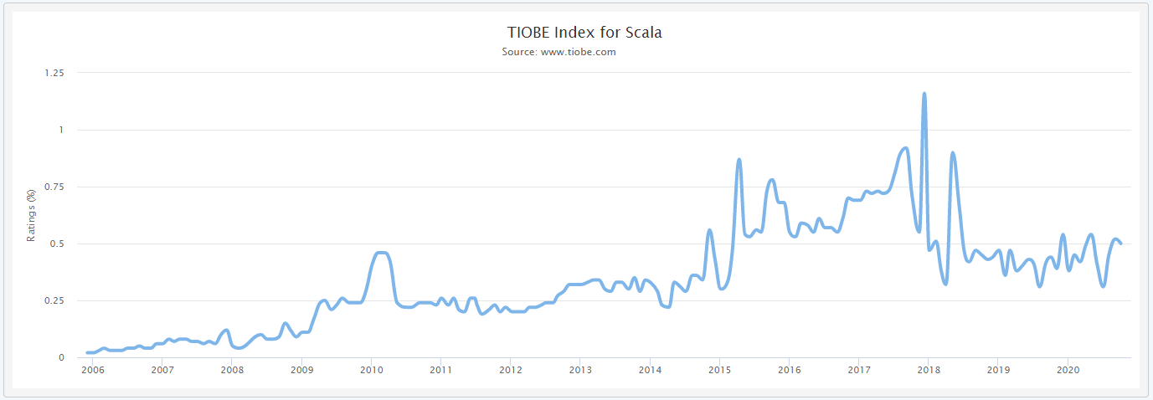
Losing popularity?

Slide 37
I want to learn more!
Learn as a functional language:
Functional ‘first’ – Scala, F#
Pure functional - Haskell

Slide 38
Questions?

